Slide 1

Developing and Promoting
Vibrant Communities
William J. Ivoska, Ph.D.
Vice President,
Student Services

Slide 2
Vibrant Communities
Degrees Awarded:
AA - Associate of Arts
AS – Associate of Science
AAS – Associate of Applied Science
AAB – Associate of Applied Business
ATS – Associate of Technical Studies

Slide 3
Vibrant Communities
Economic Contribution
c o l l e g e o p e r a t i o n s
s t u d e n t s p e n d i n g
p a s t s t u d e n t p r o d u c t i v i t y
Study by EMSI (Economic Modeling Specialists, Inc.) on the Economic Contribution of Owens Community College

Slide 4
Owens Community College
Direct income of faculty and staff
  $75.9 million net contribution to area income
Spending by students from outside our service area
  $548,000 contribution to area income
Past Student Productivity
  $581.3 million contribution to area income

Slide 5
Vibrant Communities
Social Perspective
s t u d e n t p e r s p e c t i v e
s o c i a l p e r s p e c t i v e
t a x p a y e r p e r s p e c t i v e

Slide 6
Owens Community College
Benefits – present value of increased future income
Costs – tuition, fees and opportunity cost of time
Benefits: $1.1 billion
Costs: $217.6 million
16.2% student return on investment

Slide 7
Vibrant Communities
Associate Degree Graduates earn an average of $45, 500 per year, 35% more than someone with a high school diploma
Over their future careers, earn $448, 400 more than someone with a high school diploma

Slide 8
Vibrant Communities
Education is statistically correlated with improved lifestyles
This translates into medical, crime and unemployment savings to taxpayers

Slide 9
Owens Community College
Medical $ 3.0 million
Crime $ 2.2 million
Welfare/Unemployment
        $ 553,000
    ____________________________
    $5.8 million Annual Savings

Slide 10
Owens Community College
Benefits – added tax revenue and avoided cost to government
$202.1 million annually
Costs – state and local government funding
  $53.7 million annually

Slide 11
Owens Community College
So What Does
All This Mean?

Slide 12
Vibrant Communities
Owens State Community College
(The US model of SSHE….)
  Enriches the lives of students
  Increases students’ lifetime income
  Reduces the demand for social services
  Contributes to the growth of the economy

Slide 13
Vibrant Communities
Talking to our graduates
Results of 2007-2008
  Graduate Follow-up Study

Slide 14
Vibrant Communities
27,929 Graduates

Slide 15
Vibrant Communities
Satisfaction
94% - Owens helped them achieve their primary educational goal (highest ranking)
94% - Satisfied with the quality of education in their major
62% - Availability of web-based courses (lowest ranking)

Slide 16
Vibrant Communities
Employment
69% employed Full Time, 15% part time
65% employed in their field of study
1/3 earn less than $30,000
1/3 earn $30-39,000
1/3 earn over $39,000

Slide 17
Vibrant Communities
Continuing Education
More than 50% of graduates enrolled in two or four-year colleges since graduating from Owens or plan to do so
28.6% enrolled
23.2% plan to enroll

Slide 18
Vibrant Communities
Post graduate enrollment:
32% University of Toledo
29% Owens Community College
23% BGSU
15% Lourdes College
61.3% in the same field of study

Slide 19
Vibrant Communities
The Fun Stuff

Slide 20
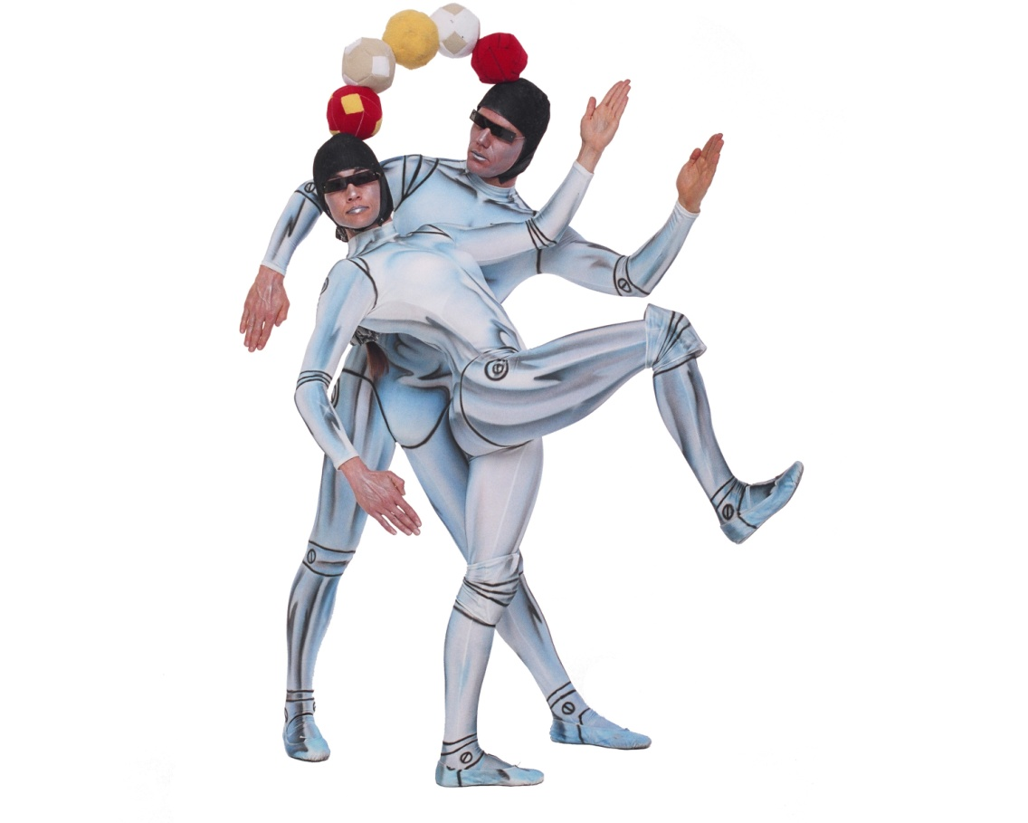
Center for Fine and Performing Arts

Slide 21
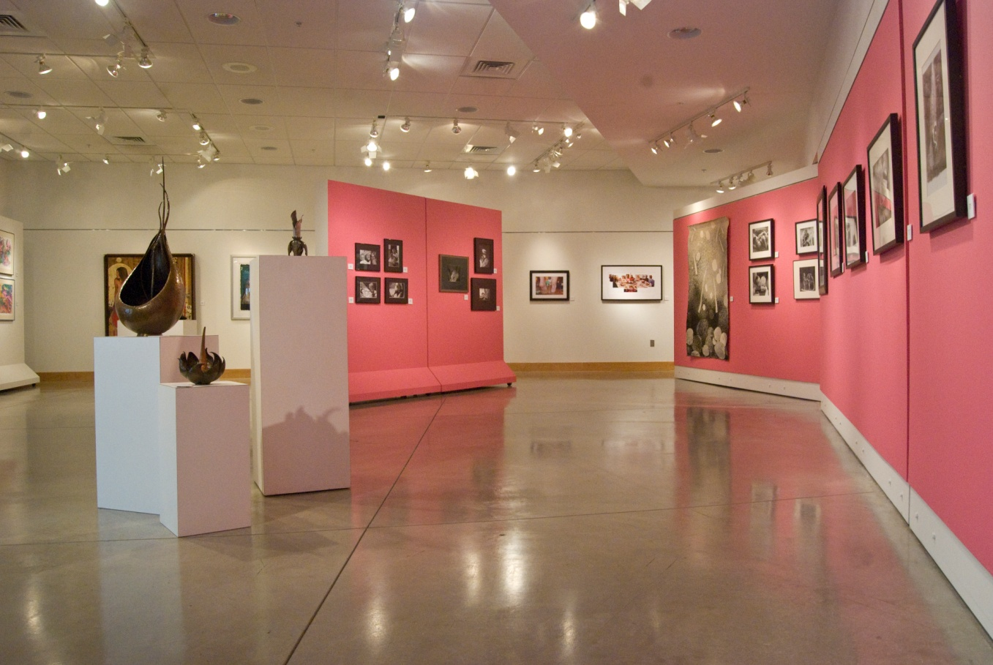
Walter E. Terhune Gallery

Slide 22
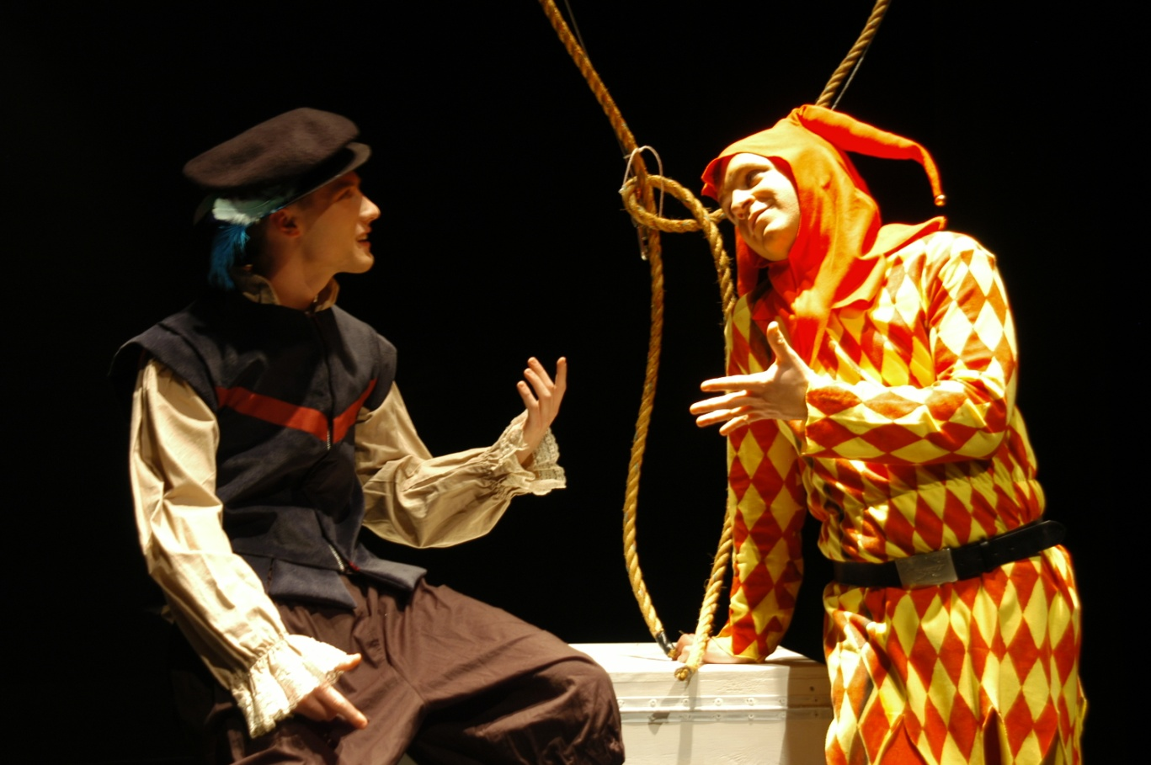
Student Plays

Slide 23
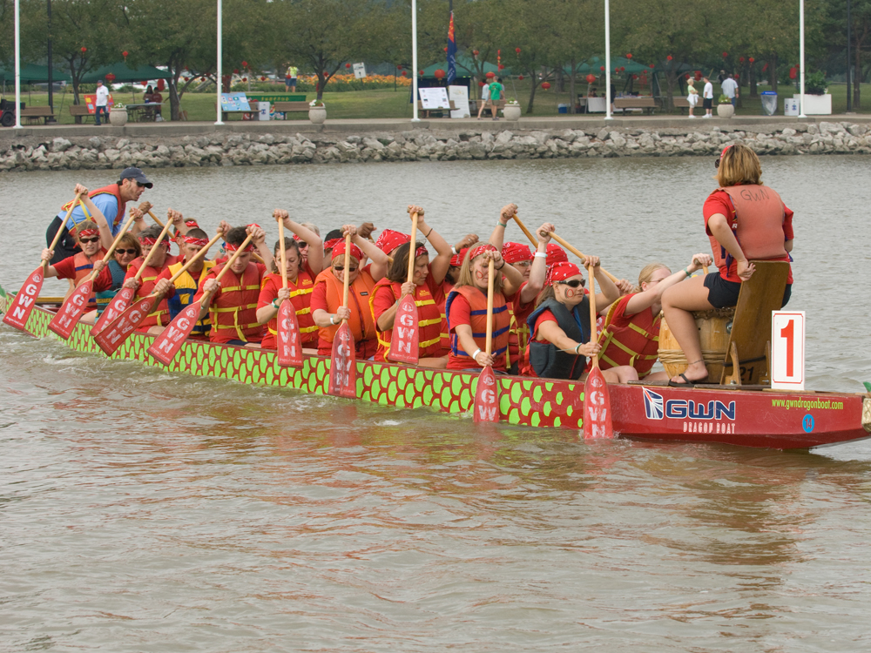
Dragon Boat Festival

Slide 24

Backpack to the Future

Slide 25
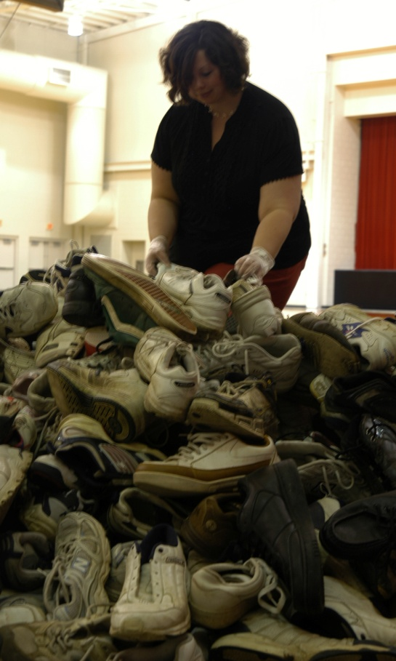
Nike Shoe Drive

Slide 26
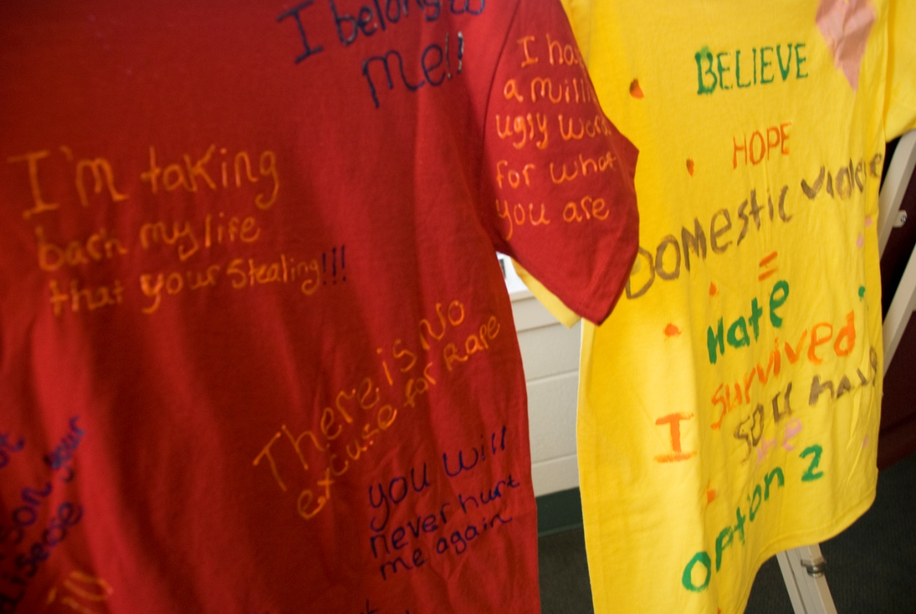
The Clothesline Project

Slide 27
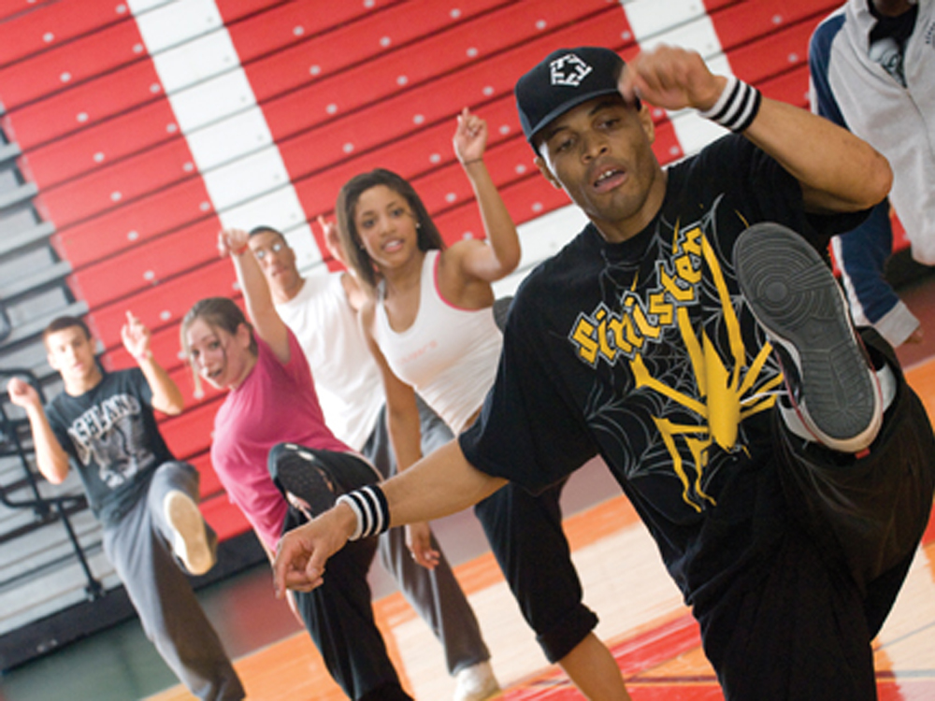
Hip Hop Explosion

Slide 28
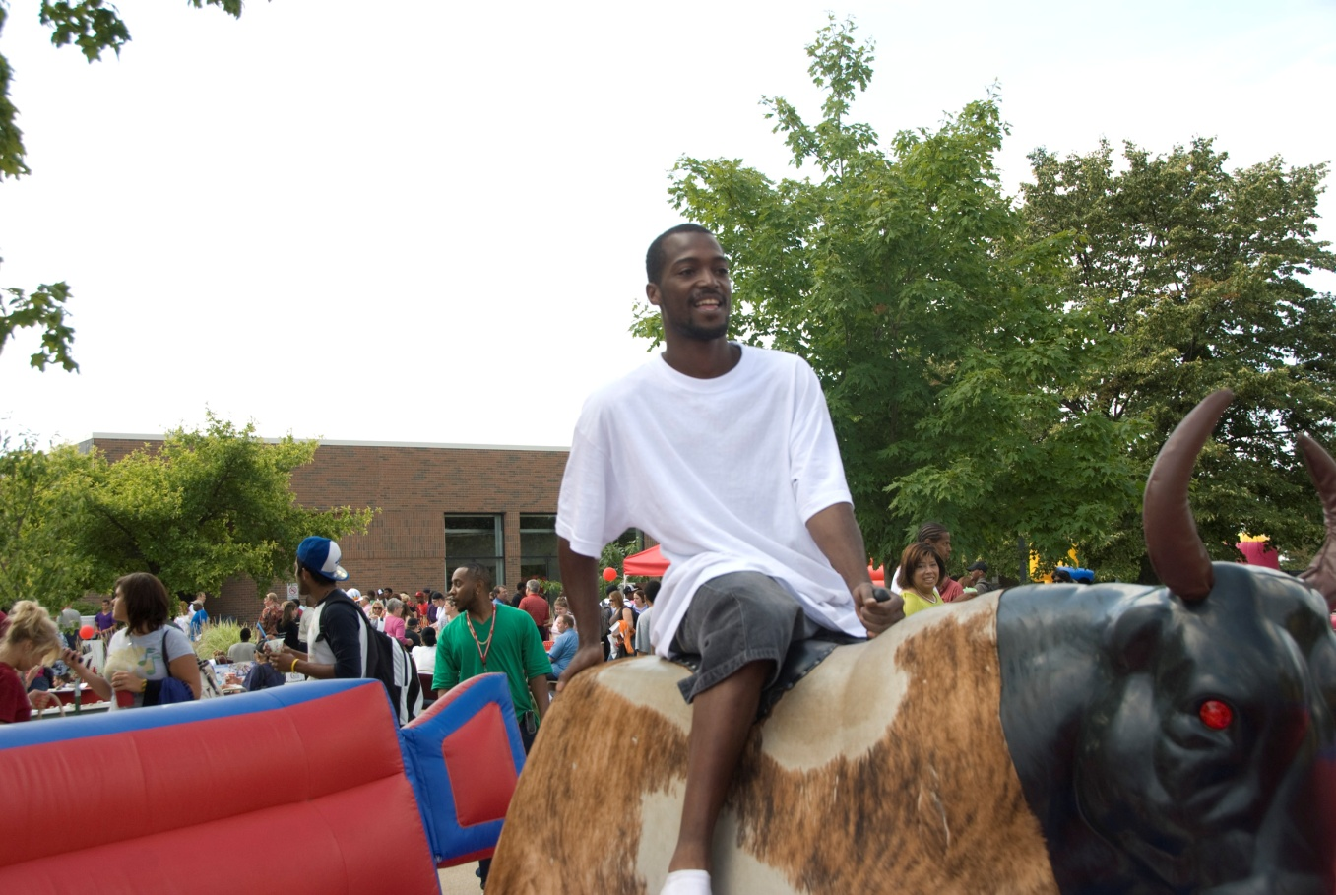
Fall Fest

Slide 29
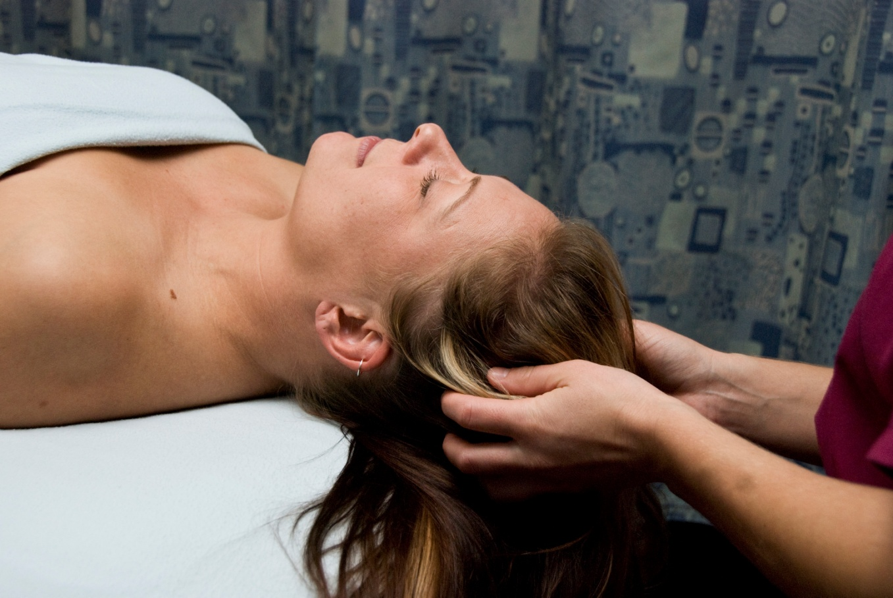
Massage Therapy

Slide 30
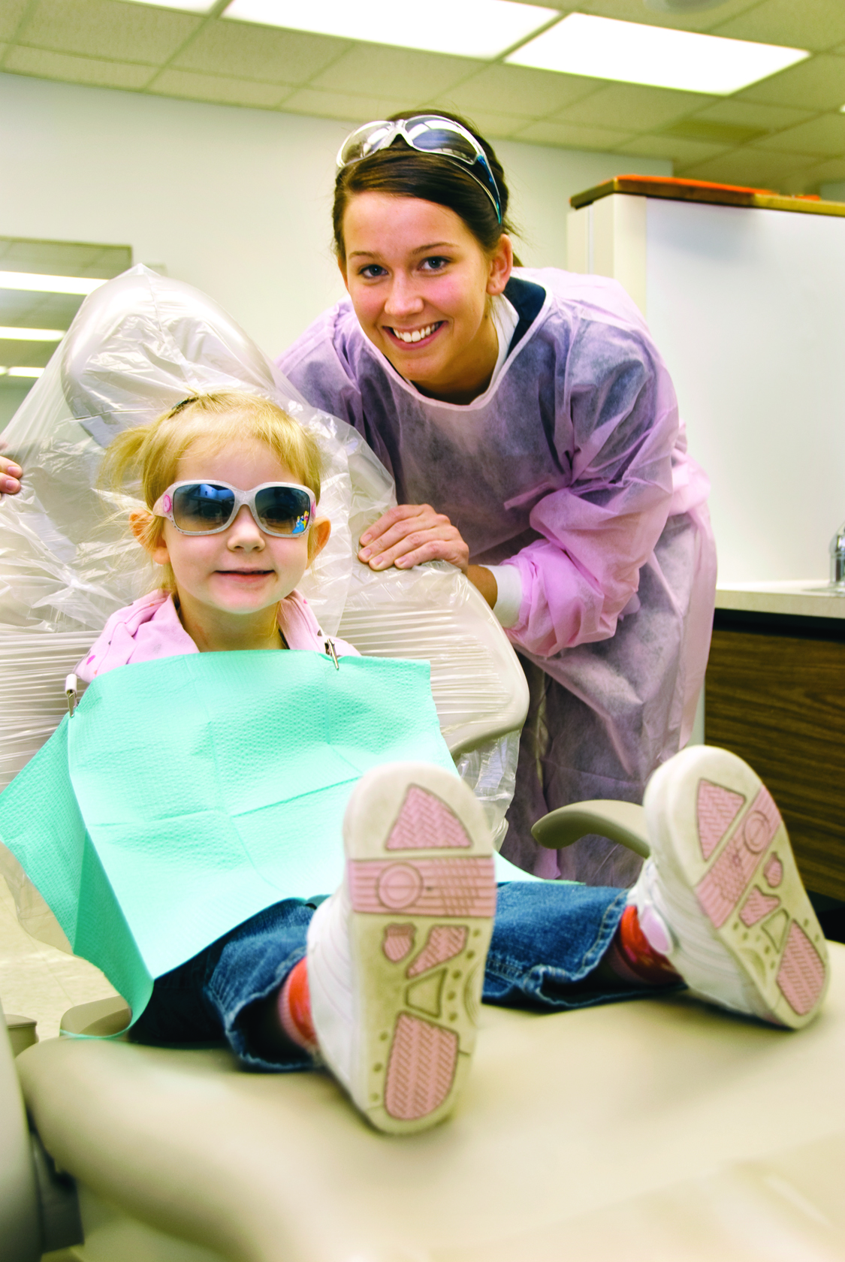
Dental Clinic

Slide 31
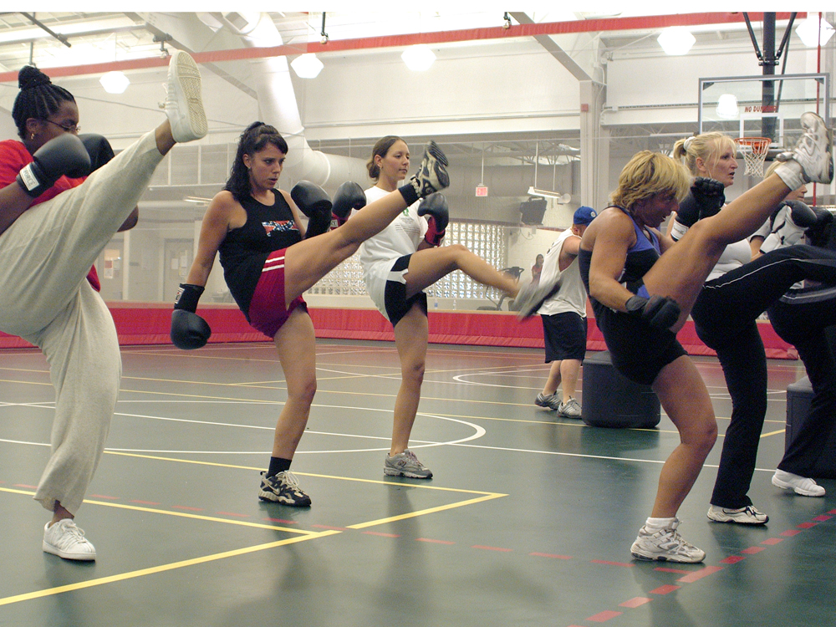
Kick Boxing Classes

Slide 32

Sports Teams

